Slide 1
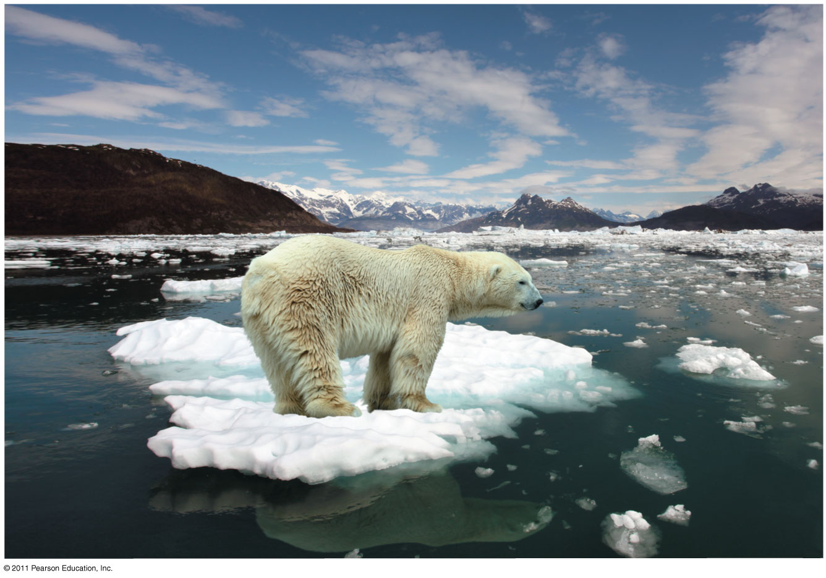
Chapter 3
Water and Life

Slide 2
The Molecule That Supports All of Life
All living organisms require water more than any other substance
Most cells are surrounded by water, and cells themselves are about 70–95% water
The abundance of water is the main reason the Earth is habitable

Slide 3
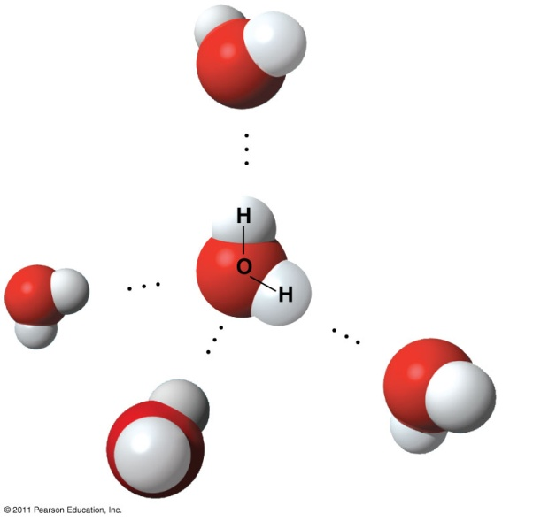
Polar covalent bonds in water molecules result in hydrogen bonding
The water molecule is a polar molecule: the opposite ends have opposite charges
Polarity allows water molecules to form hydrogen bonds with each other
Polar covalent bond
Hydrogen bond

Slide 4
Four properties of water contribute to Earth’s suitability for life
Cohesive behavior
Ability to moderate temperature
Expansion upon freezing
Versatility as a solvent

Slide 5
Cohesion of Water Molecules
Collectively, hydrogen bonds hold water molecules together, a phenomenon called cohesion
Cohesion helps the transport of water against gravity in plants
Adhesion is an attraction between different substances, for example, between water and plant cell walls

Slide 6
Adhesion of the water to cell walls by hydrogen bonds helps resist the downward pull of gravity Cohesion due to the hydrogen bonds between the water molecules helps hold the column of water with in the cells
Direction
of water
movement

Slide 7
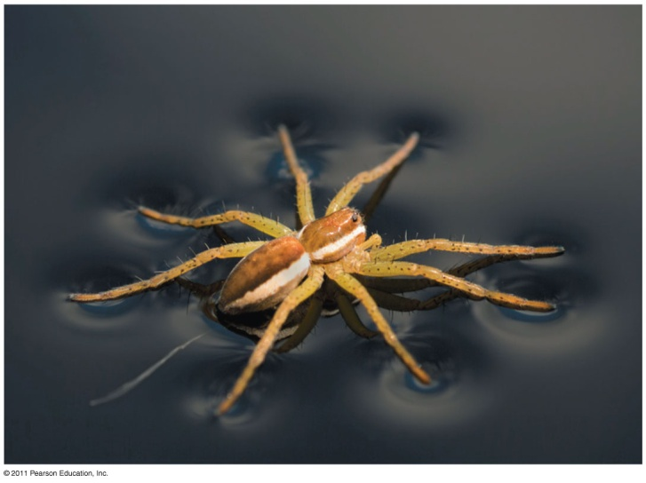
Surface tension
Surface tension is a measure of how hard it is to break the surface of a liquid
Surface tension is related to cohesion
The high surface tension of the water, results from the collective strength of its hydrogen bonds

Slide 8
Moderation of Temperature by Water
Water absorbs heat from warmer air and releases stored heat to cooler air
Water can absorb or release a large amount of heat with only a slight change in its own temperature

Slide 9
Heat and Temperature
Kinetic energy is the energy of motion
Heat is a measure of the total amount of kinetic energy due to molecular motion
Temperature measures the intensity of heat due to the average kinetic energy of molecules

Slide 10
Heat and Temperature
The Celsius scale is a measure of temperature using Celsius degrees (°C)
A calorie (cal) is the amount of heat required to raise the temperature of 1 g of water by 1°C
The “calories” on food packages are actually kilocalories (kcal), where 1 kcal = 1,000 cal
The joule (J) is another unit of energy where 1 J = 0.239 cal, or 1 cal = 4.184 J

Slide 11
Water’s High Specific Heat
The specific heat of a substance is the amount of heat that must be absorbed or lost for 1 g of that substance to change its temperature by 1ºC
The specific heat of water is 1 cal/g/ºC
Water resists changing its temperature because of its high specific heat

Slide 12
Water’s High Specific Heat
Water’s high specific heat can be traced to hydrogen bonding
Heat is absorbed when hydrogen bonds break
Heat is released when hydrogen bonds form
The high specific heat of water minimizes temperature fluctuations to within limits that permit life

Slide 13
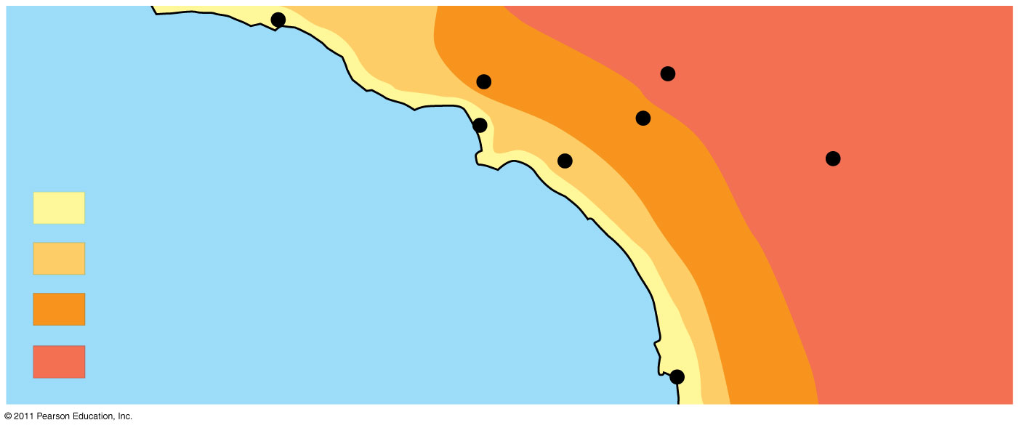
Effect of Body of water on Climate
By absorbing or releasing heat, oceans moderate coastal climates. The cool ocean reduces coastal air temperatures by absorbing heat.
Santa Barbara 73°
Burbank
90°
San Bernardino
100°
Los Angeles
(Airport) 75°
Santa Ana
84°
Palm Springs
106°
70s (°F)
80s
Pacific Ocean 68°
90s
100s
San Diego 72°

Slide 14
Relevance of Water’s High Specific Heat to Life
A large body of water can absorb and store huge amounts of heat from the sun during daytime and summer while warming up only a few degrees
At night and during the winter, the gradually cooling water can warm the air
Creates a favorable environment for marine life

Slide 15
Evaporative Cooling
Evaporation is transformation of a substance from liquid to gas
Heat of vaporization is the heat a liquid must absorb for 1 g to be converted to gas
As a liquid evaporates, its remaining surface cools, a process called evaporative cooling
Evaporative cooling of water helps stabilize temperatures in organisms and bodies of water

Slide 16
Floating of Ice on Liquid Water
Ice floats in liquid water because hydrogen bonds in ice are more “ordered,” making ice less dense
Water reaches its greatest density at 4°C
If ice sank, all bodies of water would eventually freeze solid, making life impossible on Earth

Slide 17
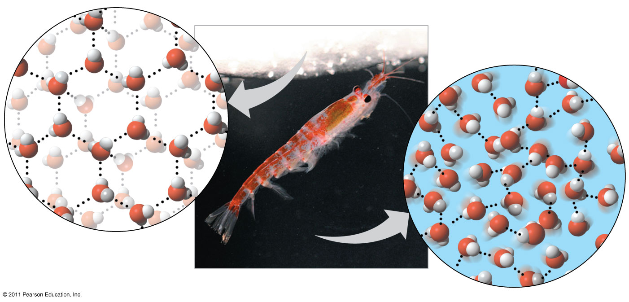
Crystalline structure of ice forms a floating barrier
Crystal is spacious, ice has fewer molecules than water, than equal volume of water
Floating ice becomes a barrier, protecting liquid from colder air
Hydrogen bond
Ice:
Hydrogen bonds
are stable
Liquid water:
Hydrogen bonds
break and re-form

Slide 18
Water: The Solvent of Life
A solution is a liquid that is a homogeneous mixture of substances
A solvent is the dissolving agent of a solution
The solute is the substance that is dissolved
An aqueous solution is one in which water is the solvent

Slide 19
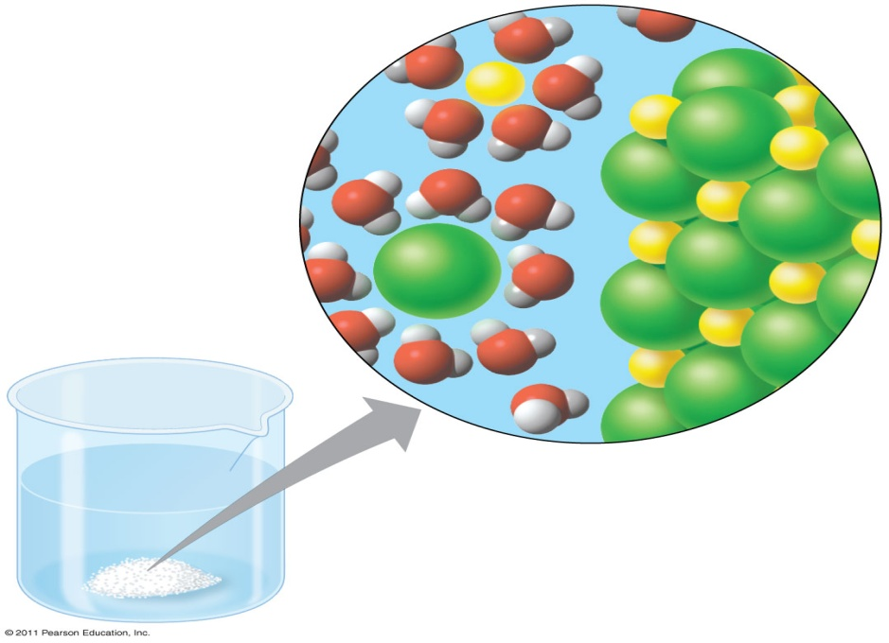
Water: The Solvent of Life
When an ionic compound is dissolved in water, each ion is surrounded by a sphere of water molecules called a hydration shell
Na⁺
⁺ −
Cl⁻

Slide 20
Water: The Solvent of Life
Water can also dissolve compounds made of nonionic polar molecules
Even large polar molecules such as proteins can dissolve in water if they have ionic and polar regions

Slide 21
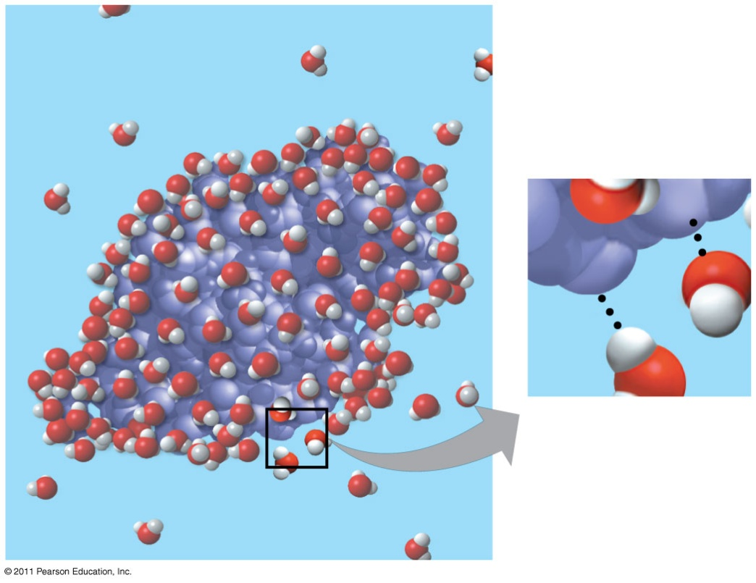
Water soluble protein
Human lysozyme, found in tears/saliva (antibacterial action)
The ionic and polar regions on the surface attract water molecules
δ
+
−
δ
−
+

Slide 22
Hydrophilic and Hydrophobic Substances
A hydrophilic substance is one that has an affinity for water
A hydrophobic substance is one that does not have an affinity for water
Oil molecules are hydrophobic because they have relatively nonpolar bonds
A colloid is a stable suspension of fine particles in a liquid

Slide 23
Solute Concentration in Aqueous Solutions
Most biochemical reactions occur in water
Chemical reactions depend on collisions of molecules and therefore on the concentration of solutes in an aqueous solution
Molecular mass is the sum of all masses of all atoms in a molecule
Numbers of molecules are usually measured in moles, where 1 mole (mol) = 6.02 x 10²³ molecules

Slide 24
Possible Evolution of Life on Other Planets with Water
The remarkable properties of water support life on Earth in many ways
Astrobiologists seeking life on other planets are concentrating their search on planets with water
To date, more than 200 planets have been found outside our solar system; one or two of them contain water
In our solar system, Mars has been found to have water

Slide 25
Subsurface ice and morning Frost on Mars

Slide 26
Acidic and basic conditions affect living organisms
A hydrogen atom in a hydrogen bond between two water molecules can shift from one to the other
The hydrogen atom leaves its electron behind and is transferred as a proton, or hydrogen ion (H⁺)
The molecule with the extra proton is now a hydronium ion (H₃O⁺), though it is often represented as H⁺
The molecule that lost the proton is now a hydroxide ion (OH–)

Slide 27
Acidic and basic conditions affect living organisms
+
−
2 H₂O
Hydronium
ion (H₃O⁺)
Hydroxide
ion (OH⁻)

Slide 28
Acidic and basic conditions affect living organisms
Water is in a state of dynamic equilibrium in which water molecules dissociate at the same rate at which they are being reformed
Though statistically rare, the dissociation of water molecules has a great effect on organisms
Changes in concentrations of H⁺ and OH– can drastically affect the chemistry of a cell

Slide 29
Acidic and basic conditions affect living organisms
Concentrations of H⁺ and OH– are equal in pure water
Adding certain solutes, called acids and bases, modifies the concentrations of H⁺ and OH–
Biologists use something called the pH scale to describe whether a solution is acidic or basic (the opposite of acidic)

Slide 30
Acids and Bases
An acid is any substance that increases the H⁺ concentration of a solution
A base is any substance that reduces the H⁺ concentration of a solution

Slide 31
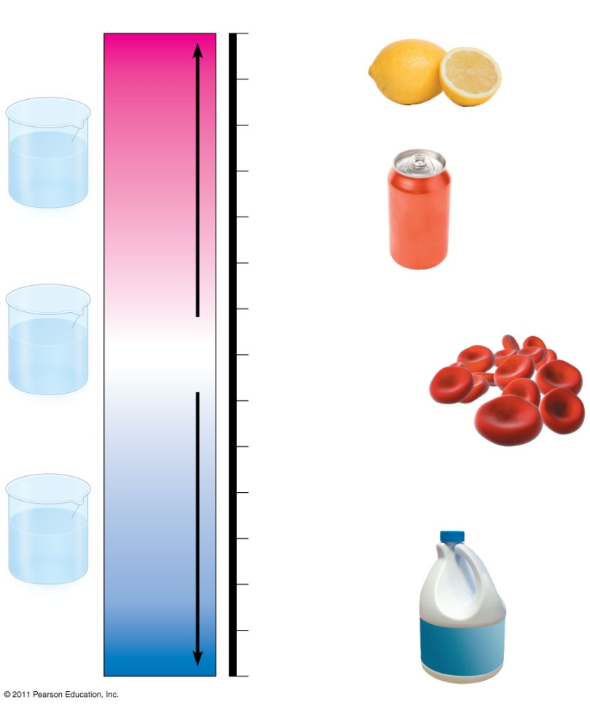
Acids and Bases
Acidic solutions have pH values less than 7
Basic solutions have pH values greater than 7
Most biological fluids have pH values in the range of 6 to 8
pH Scale
Acidic
solution
2
Gastric juice, lemon juice
H⁺] > [OH⁻]
Neutral
solution
Neutral
[H⁺] = [OH⁻
7
Pure water
Milk of magnesia
Basic
Sol.
[H⁺] < [OH⁻
14
Oven cleaner

Slide 32
Buffers
The internal pH of most living cells must remain close to pH 7
Buffers are substances that minimize changes in concentrations of H⁺ and OH– in a solution
Most buffers consist of an acid-base pair that reversibly combines with H⁺

Slide 33
Acidification: A Threat to Water Quality
Human activities such as burning fossil fuels threaten water quality
CO₂ is the main product of fossil fuel combustion
About 25% of human-generated CO₂ is absorbed by the oceans
CO₂ dissolved in sea water forms carbonic acid; this process is called ocean acidification

Slide 34
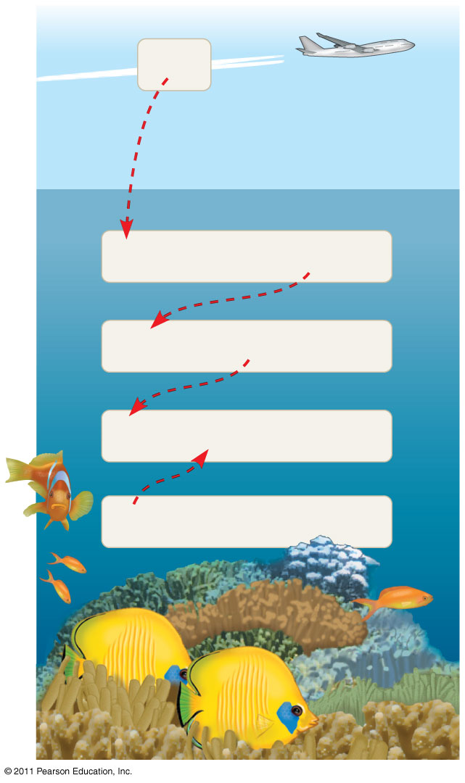
Acidification: A Threat to Water Quality
Some carbon dioxide in the atm
dissolves in the ocean. It reacts
with water to form carbonic acid
Carbonic acid dissociates to
Hydrogen ions
Bicarconate ions
added hydrogen ions combine
with carbonate ions forming
more bicarbonate
less carbonate is available
for calcification (corals)
CO₂
CO₂ + H₂O
H₂CO₃
H₂CO₃
H⁺ + HCO₃⁻
H⁺ + CO₃²⁻
HCO₃⁻
CO₃²⁻ +
Ca²⁺
CaCO₃

Slide 35
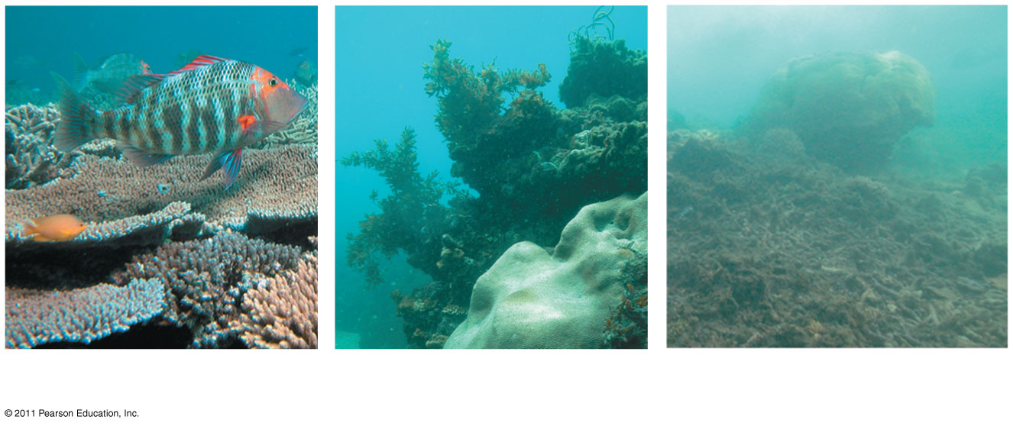
Acidification: A Threat to Water Quality
Carbonate is required for calcification (production of calcium carbonate) by many marine organisms, including reef-building corals

Slide 36
Acidification: A Threat to Water Quality
The burning of fossil fuels is also a major source of sulfur oxides and nitrogen oxides
These compounds react with water in the air to form strong acids that fall in rain or snow
Acid precipitation is rain, fog, or snow with a pH lower than 5.2
Acid precipitation damages life in lakes and streams and changes soil chemistry on land

Slide 37
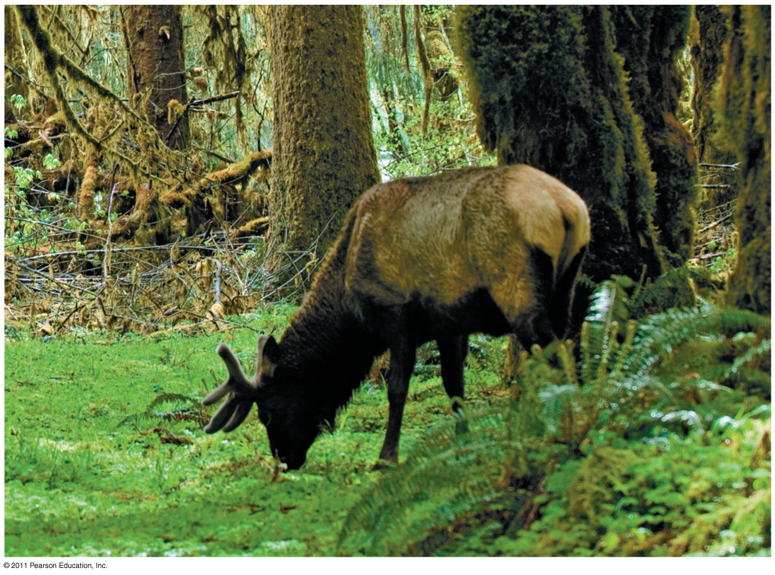
Chapter 4
Carbon and the Molecular Diversity of Life

Slide 38
Carbon: The Backbone of Life
Living organisms consist mostly of carbon-based compounds
Carbon is able to form large, complex, and diverse molecules
Proteins, DNA, carbohydrates, and other molecules that distinguish living matter are all composed of carbon compounds

Slide 39
Organic chemistry is the study of carbon compounds
Organic chemistry is the study of compounds that contain carbon
Organic compounds range from simple molecules to colossal ones
Most organic compounds contain hydrogen atoms in addition to carbon atoms

Slide 40
Carbon atoms can form diverse molecules by bonding to four other atoms
Electron configuration is the key to an atom’s characteristics
Electron configuration determines the kinds and number of bonds an atom will form with other atoms

Slide 41
Carbon atoms can form diverse molecules by bonding to four other atoms
With four valence electrons, carbon can form four covalent bonds with a variety of atoms
This ability makes large, complex molecules possible
In molecules with multiple carbons, each carbon bonded to four other atoms has a tetrahedral shape
However, when two carbon atoms are joined by a double bond, the atoms joined to the carbons are in the same plane as the carbons

Slide 42
Carbon atoms can form diverse molecules by bonding to four other atoms
Name and Comment
Molecular
Formula
Structural
Formula
Ball-and-
Stick Model
Space-Filling
Model
Methane
CH₄
Ethane
C₂H₆
Ethene
C₂H₄

Slide 43
Carbon atoms can form diverse molecules by bonding to other atoms
The electron configuration of carbon gives it covalent compatibility with many different elements
The valences of carbon and its most frequent partners (hydrogen, oxygen, and nitrogen) are the “building code” that governs the architecture of living molecules

Slide 44
Carbon atoms can form diverse molecules by bonding other atoms
Hydrogen
(valence = 1)
Oxygen
(valence = 2)
Nitrogen
(valence = 3)
Carbon
(valence = 4)

Slide 45
Carbon atoms can form diverse molecules by bonding other atoms
Carbon atoms can partner with atoms other than hydrogen; for example:
Carbon dioxide: CO₂
Urea: CO(NH₂)₂

Slide 46
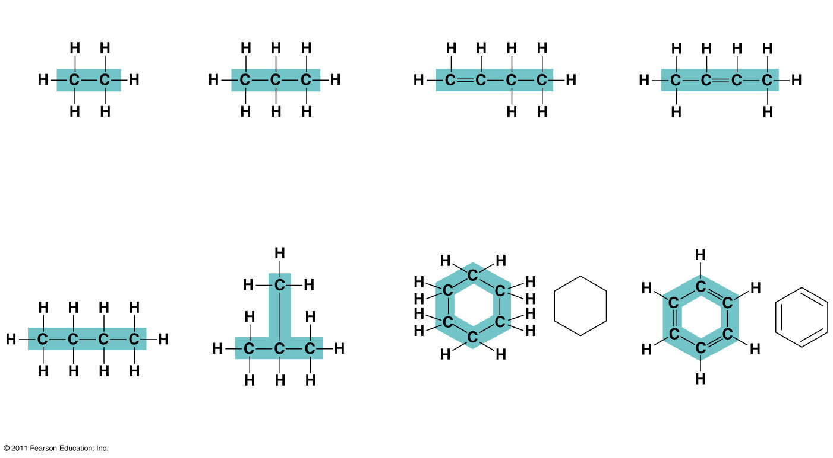
Molecular Diversity Arising from Carbon Skeleton Variation
Carbon chains form the skeletons of most organic molecules
Carbon chains vary in length and shape
Ethane
Propane
1-Butene
2-Butene

Slide 47
Hydrocarbons
Hydrocarbons are organic molecules consisting of only carbon and hydrogen
Many organic molecules, such as fats, have hydrocarbon components
Hydrocarbons can undergo reactions that release a large amount of energy

Slide 48
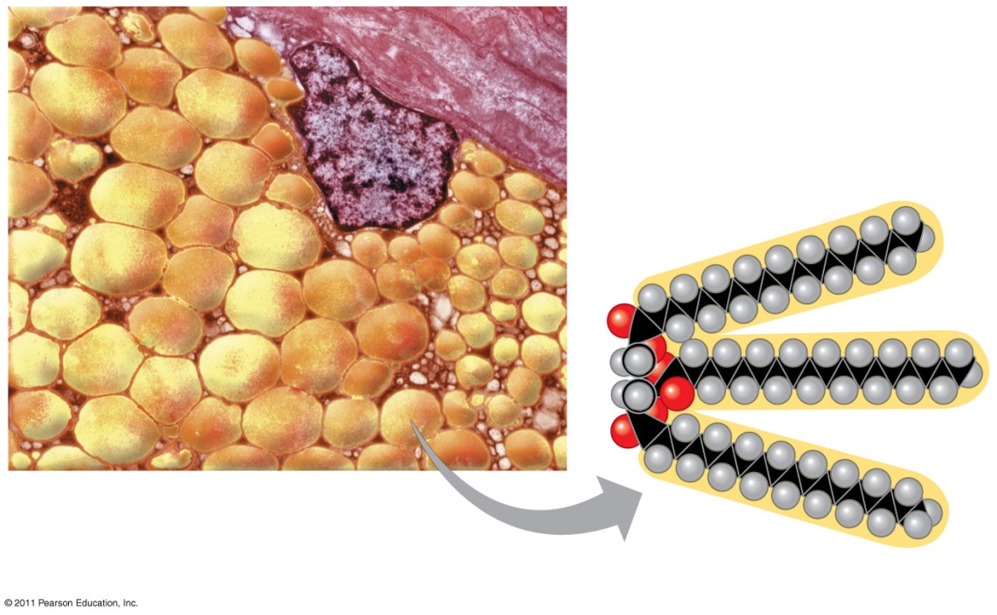
Hydrocarbons
Mammalian adipose cells stockpile fat molecules as fuel reserve
Fat molecules consist of 1 nonhydrocarbon component joined to 3 hydrocarbon tails
Part of a human adipose cell
A fat molecule

Slide 49
Isomers
Isomers are compounds with the same molecular formula but different structures and properties
Structural isomers have different covalent arrangements of their atoms
Cis-trans isomers have the same covalent bonds but differ in spatial arrangements
Enantiomers are isomers that are mirror images of each other

Slide 50
Isomers
Structural isomers
Cis-trans isomers
Enantiomers
L isomer
D isomer

Slide 51
Isomers
Enantiomers are important in the pharmaceutical industry
Two enantiomers of a drug may have different effects
Usually only one isomer is biologically active
Differing effects of enantiomers demonstrate that organisms are sensitive to even subtle variations in molecules

Slide 52
Isomers
Drug
Effective
Enantiomer
Ineffective
Enantiomer
Condition
Pain; inflammation
Ibuprofen
S-Ibuprofen
R-Ibuprofen
Albuterol
Asthma
R-Albuterol
S-Albuterol

Slide 53
A few chemical groups are key to the functioning of biological molecules
Distinctive properties of organic molecules depend on the carbon skeleton and on the molecular components attached to it
A number of characteristic groups can replace the hydrogens attached to skeletons of organic molecules

Slide 54
few chemical groups are key
Functional groups are the components of organic molecules that are most commonly involved in chemical reactions
The number and arrangement of functional groups give each molecule its unique properties

Slide 55
few chemical groups are key
The seven functional groups that are most important in the chemistry of life:
Hydroxyl group
Carbonyl group
Carboxyl group
Amino group
Sulfhydryl group
Phosphate group
Methyl group

Slide 56
few chemical groups are key
Hydroxyl
Ethanol

Slide 57
few chemical groups are key
Carboxyl
Acetic acid

Slide 58
few chemical groups are key
Amino
Glycine

Slide 59
few chemical groups are key
Phosphate
Glycerol phosphate

Slide 60
ATP: An Important Source of Energy for Cellular Processes
One phosphate molecule, adenosine triphosphate (ATP), is the primary energy-transferring molecule in the cell
ATP consists of an organic molecule called adenosine attached to a string of three phosphate groups

Slide 61
ATP
Adenosine

Slide 62
A Review
The versatility of carbon makes possible the great diversity of organic molecules
Variation at the molecular level lies at the foundation of all biological diversity
Reacts
with H₂O
Adenosine
Energy
ATP
ADP

